Slide 1
Week15 Preliminary Results
Hanqing Guo

Slide 2
Content
1. Quick Review the Benefits of Ultrasound
2. Review 4 Different Methods: sliding window, Pattern match, GMM-UBM, Google
3. Result Comparison
4. Conclusion

Slide 3
Quick Review the Benefits of Ultrasound

Slide 4
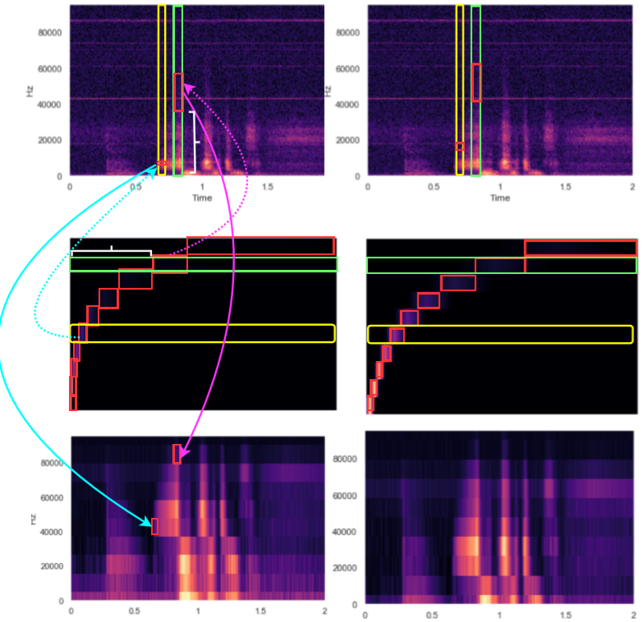
Different Scale Mel-filters
Conclusion1:
Proper mel-filter banks will
expose more high-frequency
Feature
Conclusion2:
Whatever mel-filter number choose,
It will represent all frequency
range feature

Slide 5
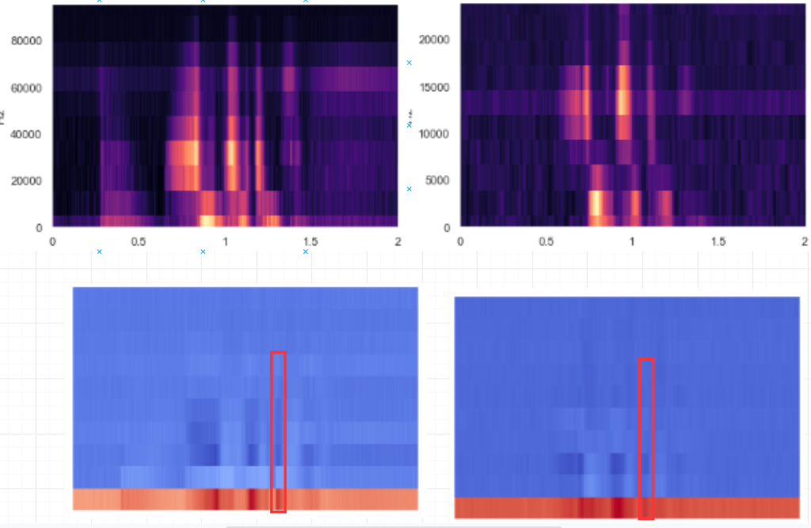
High vs Low raw data and MFCC
Conclusion3:
Ultrasound microphone data has
enriched feature because high
time resolution
the continuous identical mfcc
features are more clear compares to normal microphone.

Slide 6
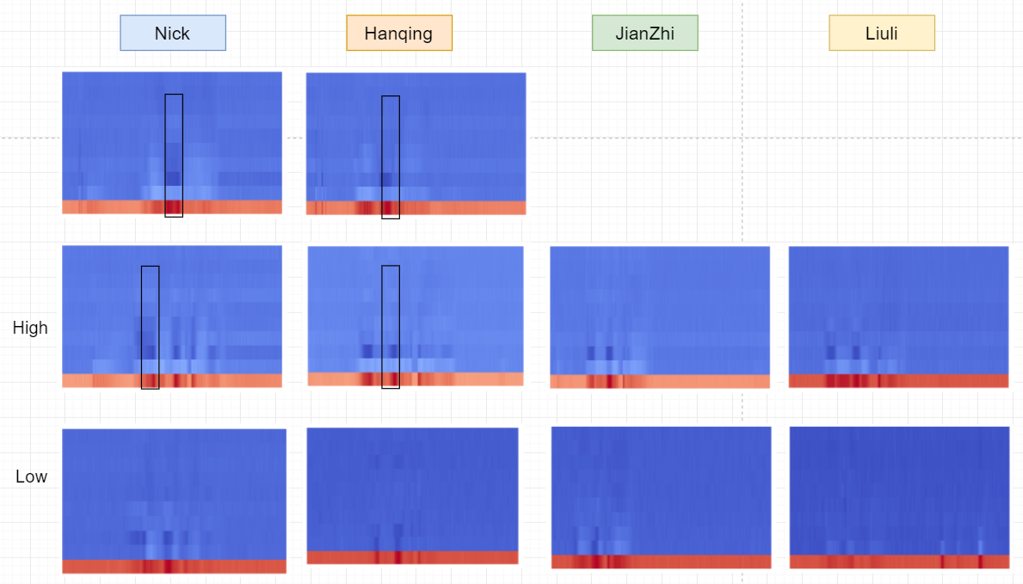
Is this MFCC identical? It seems Yes, but we will see later

Slide 7
Review four Methods

Slide 8
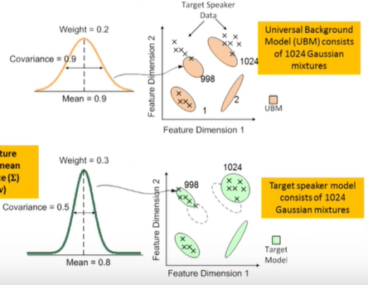
Gaussian Mixture Model
To verify 10 speakers:
1,2,3,4,5,6,7,8,9,10
Train Universal Background
Model first. Because every speaker needs
normally 1024 mixtures, while the 10 speakers
only enroll limited utterance, they are not able
to fit many mixtures.
To train UBM, need other 50 speakers, each
Speakers collects longer utterance.
Then for each speaker to be verified, fit the UBM and
Build 1024 mixtures for everyone.
Next, use maybe 50 utterance to test the speaker models

Slide 9
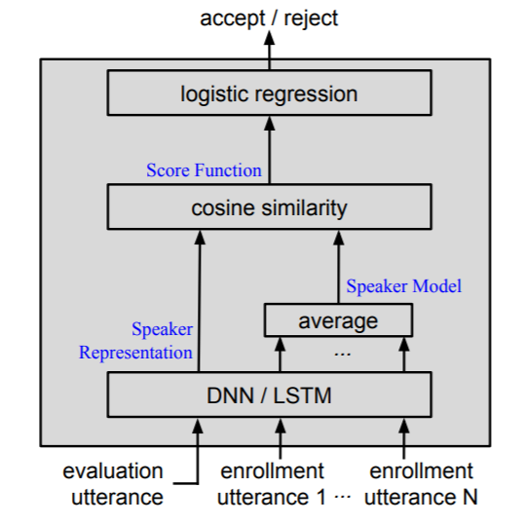
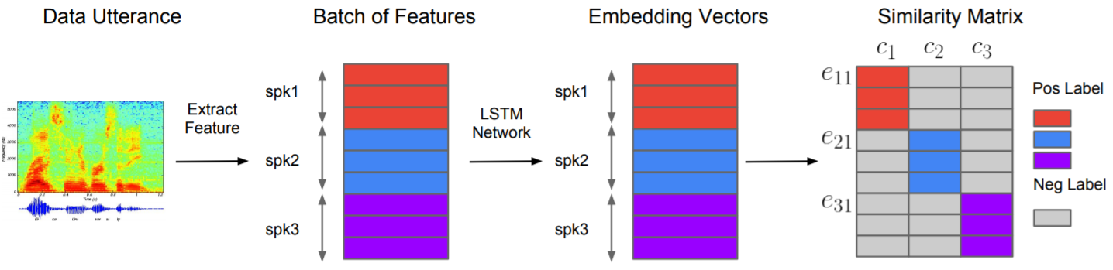
Googles Model
To verity 10 speaker: 1,2,3,4,5,6,7,8,9,10. Each speaker has 20 utterances.
Collect M speakers not includes the first 10.
Each speaker has N utterance. Total utterance N*M
For TE2E, build N*M*M tuples as (arbitrary utterance, random speaker)
For each epoch, should train N*M*M times, each time has N+1 data
The key idea is training a LSTM/DNN to output distinguished speaker model.
To verify, random split 20 utterances, say 3 to enroll, 17 to test.
Then it will test 17*10 utterance with 10 speaker model and compute the accept/reject. Further implementation will build speaker model with trained LSTM/DNN, and make decision given evaluation utterance pass through LSTM/DNN.
Instead of construct multiple tuples, GE2E use batch. Each batch contains m speakers, each speaker evaluate n utterance, each speaker enroll n utterance.
to build m*n*m matrix, then update LSTM.
Benefits: Not only far away from one speaker,
each speaker will far away from others and close to itself.

Slide 10
Sliding Model
Choose the fricative consonant as identical feature
Select the position of fricative consonant
Use mel-filters and MFCC to test if fricative consonant is
identical or not. (ultrasound vs normal microphone)
Compare similarity

Slide 11
Pattern Recognition
1. Resize image
2. Calculate Perceptual Hash value based on grey value
3. Compute hamming distance
4. Similarity definition.

Slide 12
Result Comparsion

Slide 13
GMM-UBM – Correct Previous Code
Previously:
For speaker 1, build GMM[1] using him enroll utterances as his speaker model.
Build UBM[1] using other 4 speakers enroll utterances.
Verify: Given an utterance from speaker1, for each sample, do mfcc feature conversion, for each column of mfcc feature, calculate GMM[1] score and UBM[1] score, if the GMM[1].score > UBM[1].score, then correct ++.
Acc = correct / mfcc_columns
For each sample, compare the evaluation value in GMM[k] and UBM[k], where k is speaker id

Slide 14
GMM-UBM – High Freq
 | Sample level |  | Utterance Level
High | Random enroll | Only enroll fricative | Only enroll fricative |  | Random enroll
 |  |  | Err_accept | Err_reject | Err_accept | Err_reject
Hanqing | 31% | 35% | 9.3% | 6.5% | 5% | 10%
Jianzhi | 23% | 38% | 3% | 10% | 0.67% | 10%
Liuli | 31% | 40% | 12.6% | 0% | 11% | 3%
Nick | 25% | 32% | 3.9% | 6.5% | 9.3% | 3%
Xiao | 24% | 44% | 10.6% | 3% | 13% | 0

Slide 15
GMM-UBM – Low Freq
 | Utterance Level
Low | Random enroll |  | Only enroll fricative
 | Err_accept | Err_reject | Err_accept | Err_reject
Hanqing | 4% | 20% | 4% | 20%
Jianzhi | 2.4% | 8% | 1.6% | 0%
Liuli | 6.4% | 16% | 4% | 20%
Nick | 4% | 16% | 4% | 20%
Xiao | 4.8% | 16% | 4.8% | 20%

Slide 16
Conclusion2:
GMM UBM model can be considered as baseline model.
High frequency data contains more sample; thus it can fit Gaussian model with more component
There is no obvious difference to enroll fricative utterance
High frequency data may not beat low frequency only, while it has lower error reject.

Slide 17
Q3: Sliding Window Performance

Slide 18
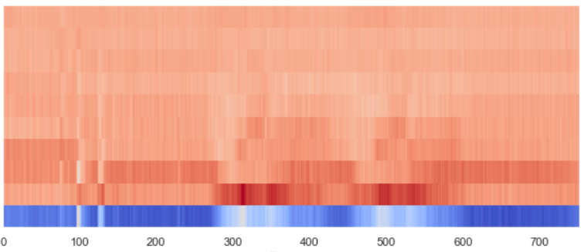
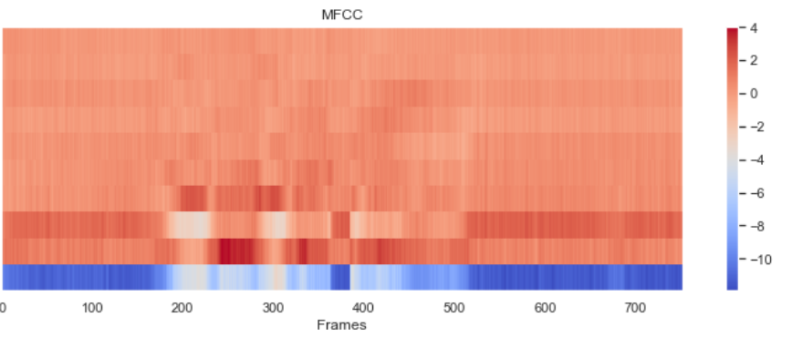
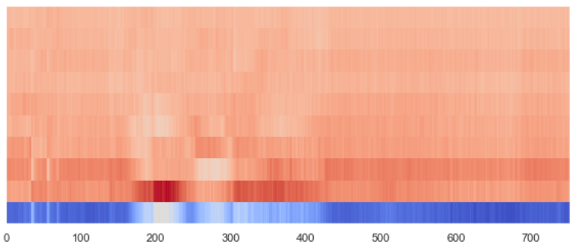
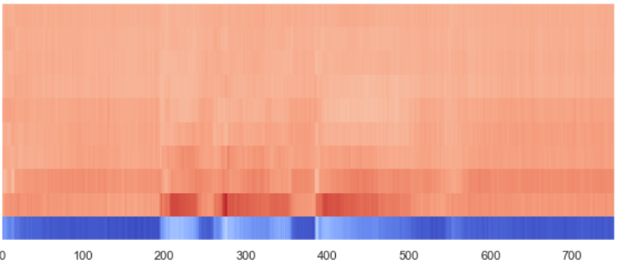
1: Find Fricative Consonant
Hello-hello
Hi Siri
Width = 20 frames
Calculate Cosine Similarity
Open the door

Slide 19
2: Result Analysis – High Frequency Data
 | Err Accept | Err Reject | Avg-Err Accept | Avg-Err Reject
Hanqing | 7.8% | 13.3%
Jianzhi | 8.5% | 0%
LiLiu | 5.5% | 13.3%
Nick | 8.5% | 13.3%
Xiao | 7.8% | 13.3%
 |  |  | 7.62% | 10.64%
Set Sum similarity
as threshold

Slide 20
2: Result Analysis – Low Frequency Data
 | Err Accept | Err Reject | Avg-Err Accept | Avg-Err Reject
Hanqing | 13.3% | 0%
Jianzhi | 16.6% | 0%
LiLiu | 13.3% | 13.3%
Nick | 20% | 13.3%
Xiao | 10% | 13.3%
 |  |  | 14.64% | 7.98%
Set Sum similarity
as threshold

Slide 21
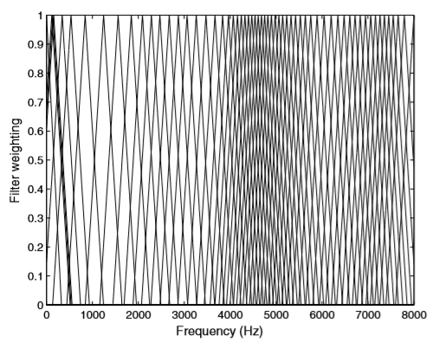
Key Idea is Find the Invariant Feature
1. Change MFCC Filters – different people apply different filters,
Emphasis some frequency part
[5] Lu, X., & Dang, J. (2008). An investigation of
dependencies between frequency components and
speaker characteristics for text-independent speaker
identification. Speech communication, 50(4), 312-322.

Slide 22
Next
Reverse the MFCC feature
Find fricative consonant
More criteria: Number of most similar, convert non-fricative to fricative, adjust width. Design NN to adjust parameters
Apply to Google Model

